Slide 1
MODULE V

Slide 2
Syllabus
Data file operations –opening and closing files-reading and writing from file-Classes and file operations
Other object oriented languages – Java – Object oriented features in Java –Comparison with C++-Object oriented system development-object oriented notations and graphs-object oriented analysis-object oriented design.

Slide 3
File manipulations
For using a file in a program we need to decide upon the following things,
A suitable name for the file
Data type and structure
Purpose
Opening method
A file is defined using the classes ifstream , ofstream and fstream contained in the header file fstream. The class to be used is based on the purpose whether we want to read data from file or write data to the file.

Slide 4
Opening and closing a file
Opening a file
Using the constructor function of the class
Using the member function open() of the class
Using constructor
ofstream outfile(“results”);
This creates outfile as an object of ofstream that manages the output stream(for write operations). This opens the file results and attaches that to the output stream outfile.
ifstream infile(“data”);
opens the file with the name data for reading purpose and attaches it to the input stream infile.

Slide 5
Now , data read and write can be done by statements like..
outfile<<total;
outfile<<sum;
infile>>number;
infile>>string;
Closing a file:-
infile.close();
outfile.close();

Slide 6
File read/write operation
#include<iostream>
#include<fstream>
using namespace std;
int main()
{
ofstream outf("item");
cout<<"enter item name\n";
string name;
cin>>name;
outf<<name<<"\n";
cout<<"enter item cost\n";
float cost;
cin>>cost;
outf<<cost;
outf.close();
ifstream inf("item");
inf>>name;
inf>>cost;
cout<<"\n";
cout<<"item name= "<<name;
cout<<"cost = "<<cost;
inf.close();
return 0;
}

Slide 7
File - open()
open() - Can be used to open multiple files that use the same stream object.
Ie if we want to process a set of files sequentially, we may create a single stream object that use it to open each file in turn .
Syntax:
file-stream-class stream-object;
stream-object.open(“filename”);

Slide 8
Eg: -
Ofstream Outfile ;
Outfile.open(“DATA1);
………
……
Outfile.close();
Outfile.open(“DATA2);
………
……
Outfile.close();
…….
………….

Slide 9
Write a program that reads a text file and creates another file that is identical except that along with each word, the number of characters in that word is also written.

Slide 10
About open() : File modes
open (filename, mode); Where filename is a string representing the name of the file to be opened, and mode is an optional parameter with a combination of the following flags:
ios::in Open for input operations.
ios::out Open for output operations.
ios::binary Open in binary mode.
ios::ate Set the initial position at the end of the file.
If this flag is not set, the initial position is the beginning of the file.
ios::app All output operations are performed at the end of the file, appending the content to the current content of the file.

Slide 11
ios:: noreplace open files if the file already exists
ios::nocreate open fails if the file does not exist
ios::trunc Delete the contents of file if it already exists
All these flags can be combined using the bitwise operator OR (|). For example, if we want to open the file example.bin in binary mode to add data we could do it by the following call to member function open:
ofstream myfile; myfile.open ("example.bin", ios::out | ios::app | ios::binary);

Slide 12
Checking state flags
The following member functions exist to check for specific states of a stream (all of them return a boolean value):
bad() Returns true if a reading or writing operation fails.
For example, in the case that we try to write to a file that is not open for writing or if the device where we try to write has no space left.
fail() Returns true in the same cases as bad(),
but also in the case that a format error happens, like when an alphabetical character is extracted when we are trying to read an integer number.
3. eof() Returns true if a file open for reading has reached the end.
good() It is the most generic state flag: it returns false in the same cases in which calling any of the previous functions would return true.
Note that good and bad are not exact opposites (good checks more state flags at once).These four functions are used for checking errors in file handling operations.

Slide 13
is_open(); -- Checking for opened file.
Checks if the file is opened or not, returns true if the file is opened else false .
gcount() : - Number of bytes already read.
Returns count of the bytes read from the file
ignore() : Ignoring characters during file read.
Ignores n bytes from the file. (get pointer is positioned after n character).
peek() : Checking next character.
Checks the next available character, will not increase the get pointer to next character. Random access (only for binary files).

Slide 14
Functions for manipulation of file pointers
Each file(binary) is associated with two pointers known as file pointers. One is called inputpointer or getpointer and the other is outputpointer or putpointer.
tellg() and tellp()
These two member functions with no parameters return a value of the member type streampos, which is a type representing the current get position (in the case of tellg) or the put position (in the case of tellp). seekg() and seekp()
These functions allow to change the location of the get and put positions. Both functions are overloaded with two different prototypes. The first form is: seekg ( position ); seekp ( position ); Using this prototype, the stream pointer is changed to the absolute position (counting from the beginning of the file).

Slide 15
The other form for these functions is: seekg ( offset, refposition ); seekp ( offset, refposition );
Using this prototype, the get or put position is set to an offset value relative to some specific point determined by the parameter refposition.
refposition takes one of the following three values from the ios class
ios::beg
ios::cur
ios::end of file

Slide 16
Methods to read/write contents
get() - Reads a single character from the file
int get();
istream& get (char& c);
2. getline() -
istream& getline (char* s, streamsize n );
istream& getline (char* s, streamsize n, char delim );
Extracts characters from the stream as unformatted input and stores them into s as a c-string, until either the extracted character is the delimiting character, or n characters have been written to s (including the terminating null character).
3. put() –Writes a single character to the associated stream.
Eg:- outfile.put(ch);

Slide 17
4. Write((char *)& v, sizeof(v)) - Writes using binary format
First parameter is the address of the variable and the second is the size of the variable.
Address of variable must be cast to char * (pointer to character).
Eg: -
outfile.write((char*)&height ,sizeof(height));
where height is a floating point number array
5. Read((char *)& v, sizeof(v)) – Reads in binary format
Binary format is more accurate in storing numbers as they are stored in the exact internal representation.

Slide 18
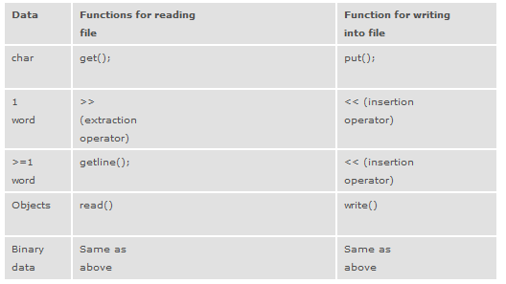
For reading and writing operations

Slide 19
Illustration of getline()
#include<iostream>
#include<fstream>
using namespace std;
int main()
{
ofstream fout;
fout.open("students");
fout<<"Joe \n";
fout<<"Bob\n";
fout<<"Alice\n";
fout.close();
fout.open("interested subjects");
fout<<"theory of Computation ";
fout<<"Programming concepts ";
fout<<"Discrete Mathematics ";
fout.close();
//Reading the files
int N=80;
char line[N];
ifstream im;
im.open("students");
cout<<":contents of students file\n";
while(im)
{
im.getline(line, N);
cout<<line;
cout<<"\n";
}
im.close();
im.open("interested subjects");
cout<<"subject file\n";
while(im)
{
im.getline(line , N);
cout<<line;
cout<<"\n";
}
im.close();
return 0;
}

Slide 20
Illustration of get ()
#include<iostream>
#include<fstream>
using namespace std;
int main()
{
ofstream fout;
fout.open("students");
fout<<"Joe \n";
fout<<"Bob\n";
fout<<"Alice\n";
fout.close();
fout.open("interested subjects");
fout<<"theory of Computation \n ";
fout<<"Programming concepts \n";
fout<<"Discrete Mathematics \n ";
fout.close();
//Reading the files
char line;
ifstream im;
im.open("students");
cout<<":contents of students file\n";
while(im.eof()==0)
{
im.get(line);
cout<<line;
cout<<"\n";
}
im.close();
im.open("interested subjects");
cout<<"subject file\n";
while(im.eof()==0)
{
im.get(line);
cout<<line;
cout<<"\n";
}
im.close();
return 0;
}

Slide 21
Use of read and write functions
#include<iostream>
#include<fstream>
using namespace std;
int main()
{
float height[4]= { 175.5,153.6 ,10.4,194.5};
float height1[10];
ofstream outf;
outf.open("binary");
outf.write((char*)&height , sizeof(height));
outf.close();
ifstream tf;
tf.open("binary");
tf.read((char*)&height1 , sizeof(height1));
cout<<"values are\n";
for(int i=0;i<4;i++)
{
cout<<height1[i];
cout<<"\n";
}
tf.close();
}

Slide 22
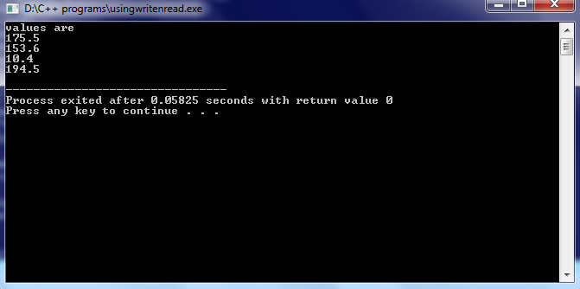

Slide 23
Writing objects into file
int main()
{
student s[62],sout[62];
ofstream fs;
fs.open("s4csa");
cout<<"enter details\n";
for(int i=0;i<62;i++)
{
s[i].getdata();
fs.write((char*)&s[i],sizeof(s[i]));
}
fs.close();
ifstream f;
f.open("s4csa");
for(int i=0;i<62;i++)
{
f.read((char*)&sout[i],sizeof(sout[i]));
sout[i].display();
}
f.close();
return 0;
}
#include <iostream>
#include<fstream>
using namespace std;
class student
{
public:
int rollno;
string name;
void getdata()
{
cout<<“enter name and roll number\n”;
cin>>name;
cin>>rollno ;
}
void display()
{
cout<<" name =" <<name;
cout<<"rollnumber="<<rollno;
}
};

Slide 24
JAVA Language
Developed by Sun Microsystems ,in the year 1991
A team under the leadership of James Gosling
Initially , it was named as oak and renamed to java in 1995
Was developed to overcome the limitations of C and C++ in terms of portability and reliability.
It is purely object oriented language.

Slide 25
JAVA Features
Compiled and interpreted.
Compiler converts to bytecode, and interpreter converts the bytecode to machine representation for execution.
Platform independent and portable
Object Oriented
Robust and secure
Distributed
Multithreaded and Interactive
High performance
Dynamic and Extensible

Slide 26
Features of java
Simple
Object-Oriented
Platform independent
Secured
Robust
Architecture neutral
Portable
Dynamic
Interpreted
High Performance
Multithreaded
Distributed

Slide 27
Simple : -
According to Sun, Java language is simple because: syntax is based on C++ (so easier for programmers to learn it after C++). removed many confusing and/or rarely-used features e.g., explicit pointers, operator overloading etc.
No need to remove unreferenced objects because there is Automatic Garbage Collection in java.
Platform Independence: - Java code is compiled by the compiler and converted into bytecode.This bytecode is a platform independent code because it can be run on multiple platforms i.e. Write Once and Run Anywhere.

Slide 28
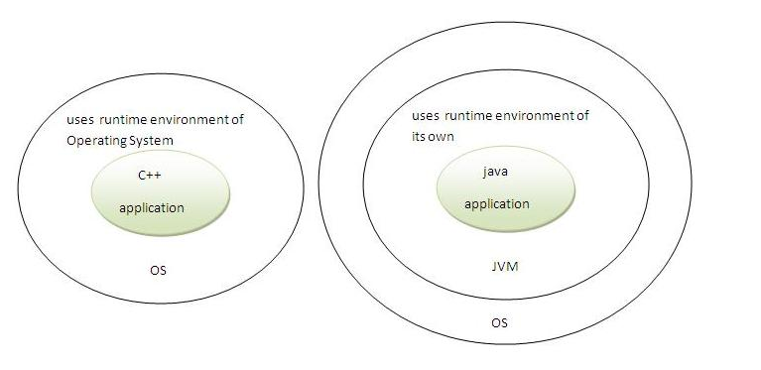
Secure: -
Java is secured because - No explicit pointer
Programs run inside Java virtual machine.

Slide 29
Features (contd…)
Robust
Robust simply means strong. Java uses strong memory management. There are lack of pointers that avoids security problem. There is automatic garbage collection in java. There is exception handling and type checking mechanism in java. All these points makes java robust.
Architecture-neutral
There is no implementation dependent features e.g. size of primitive types is set.
Portable
We may carry the java bytecode to any platform.
High-performance
Java architecture is designed to reduce overhead during run-time. Also the availability of multithreading enhances the overall speed of execution of program.

Slide 30
Distributed:-
We can create distributed applications in java. RMI and EJB are used for creating distributed applications. We may access files by calling the methods from any machine on the internet.
Multi-threaded:-
A thread is like a separate program, executing concurrently. We can write Java programs that deal with many tasks at once by defining multiple threads. The main advantage of multi-threading is that it shares the same memory.
Threads are important for multi-media, Web applications etc.

Slide 31
class Simple{
public static void main(String args[])
{
System.out.println("Hello Java");
}
}

Slide 32
OOPs (Object Oriented Programming System)
Object-Oriented Programming is a methodology or paradigm to design a program using classes and objects. It simplifies the software development and maintenance by providing some concepts:
Object based programming language follows all the features of OOPs except Inheritance. JavaScript and VBScript are examples of object based programming languages.
Object
Class
Inheritance
Polymorphism
Abstraction
Encapsulation
Dynamic binding
Message Passing

Slide 33
Object:- Objects are the basic runtime entities in an object oriented system.
They can be used to represent physical and logical entities like chair, pen, table, keyboard, bike , person, students etc.
Class: - The entire set of data and code of an object is made a user defined data type using the concept of class.
Once a class is defined, any number of objects of that class can be created.
Inheritance : - one object acquiring all the properties and behaviours of parent object is known as inheritance. It provides code reusability. It is used to achieve runtime polymorphism.
Polymorphism : -Means the ability to take more than one form. When one task is performed by different ways it is known as polymorphism.

Slide 34
Abstraction : - Hiding internal details and showing functionality is known as abstraction.
Encapsulation : - Binding (or wrapping) code and data together into a single unit is known as encapsulation.
- A java class is the example of encapsulation.
Dynamic Binding : -The code associated with a function call is determined only at run-time.
Message Communication:- Objects communicate by sending and receiving messages. It involves specifying the name of the object, name of method and the information to be sent.
Eg: - employee.salary(name);
(Object, Message and Information)

Slide 35
Comparison between Java and C++
Both Java and C++ support object oriented programming, yet there are differences between them.
C++
C++ supports both procedural and object oriented programming; therefore, it is called a hybrid language.
C++ supports structures, unions, templates, operator overloading, pointers and pointer arithmetic.
C++ support destructors, which is
automatically invoked when the object is destroyed.
Conditional inclusion (#ifdef , #ifndef type) is one of the main features of C++..
C++ has no built in support for threads. C++ relies on non-standard third-party libraries for thread support.
JAVA
Java is a pure object oriented programming language; therefore, everything is an object in Java.
Java does not support pointers, templates, unions, operator overloading, structures etc. But of course it supports references.
Java supports automatic garbage collection. It does not support destructors as C++ does.
Java does not support conditional compilation and inclusion
Java has built in support for threads. In Java, there is a Thread class that you inherit to create a new thread and override the run() method.

Slide 36
Comparison ( Contd…)
JAVA
Java does not support default arguments. There is no scope resolution operator (::) in Java.
There is no goto statement in Java. The keywords const and goto are reserved, even though they are not used.
Java doesn't provide multiple inheritance, at least not in the same sense that C++ does.
Exception handling in Java is different.
In Java, try/catch must be defined if the function suspects that it may throw an exception.
C++
C++ supports default arguments. C++ has scope resolution operator (::) which is used to define a method outside a class and to access a global variable within from the scope ,where a local variable also exists with the same name.
C++ has goto statement. However, it is not considered a good practice to use goto statement.
C++ does support multiple inheritance. The keyword virtual is used to resolve ambiguities during multiple inheritance if there is any.
While in C++, you may not include the try/catch even if the function throws an exception.

Slide 37
Comparison ( Contd…)
JAVA
Java has method overloading, but no operator overloading. The String class does use the + and += operators to concatenate strings and String expressions.
Java has built-in support for documentation comments (/** ... */); therefore, Java source files can contain their own documentation, which is read by a separate tool usually javadoc and reformatted into HTML. This helps keeping documentation maintained in easy way.
Java is platform independent.
C++
C++ supports both method overloading and operator overloading
C++ does not support documentation comments.
C++ generates object code and the same code may not run on different platforms.

Slide 38
Object-Oriented Notation and Graphs
Graphical notations are an essential part of any design and development process, and object-oriented design is no exception. We need notations to represent classes, objects, subclasses, and their inter-relationships. Unfortunately, there are no standard notations for representing the object and their interactions.
Authors and researchers have used their own notations. Some of them are used more frequently while others are not. Some commonly used notations are,
1. Classes and objects.
2. Instances of objects.
3. Message communication between and objects.
4. Inheritance relationship.
5. Classification relationship.
6. Composition relationship.
7. Hierarchical chart.
8. Client-Server relationship.
9. Process layering

Slide 39
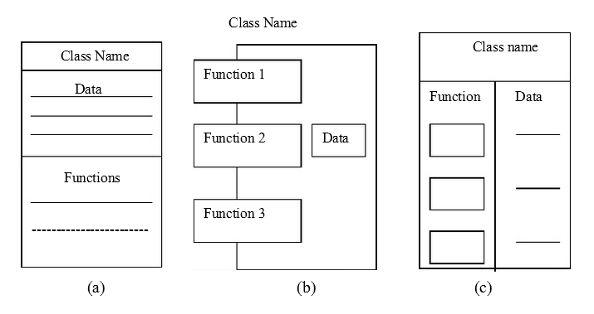
These notations and graphs are to be used wherever possible. They improve not only the clarity of the processes but also the productivity of the software developers.
Various forms of representation of classes

Slide 40
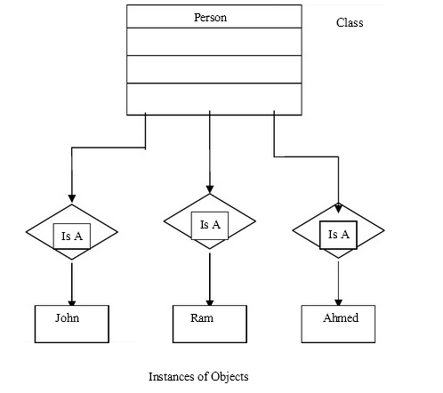
Representation of objects

Slide 41
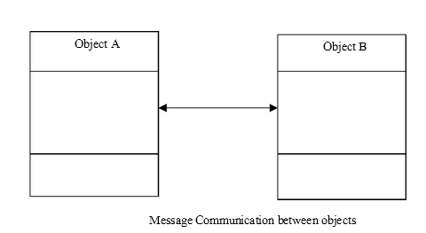
Message passing

Slide 42
Inheritance relationship
Class A
Base class
Class B
Derived Class

Slide 43
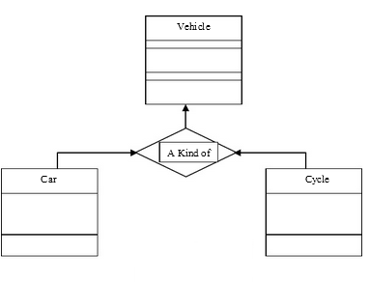
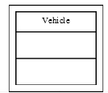
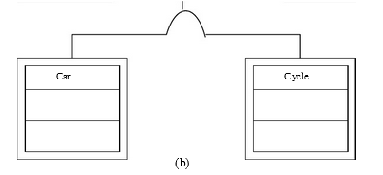
Classification relationship
The term generalization is used to specify the classification relationship. In the case of classes, the generalization/classification relationship expresses the fact that the elements of one class are also described by another. The generalization relationship signifies 'is a' or 'is a kind of'.

Slide 44
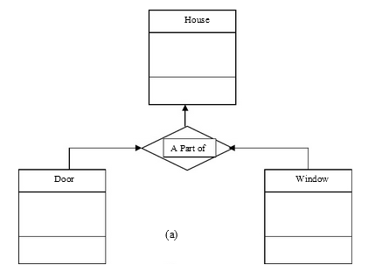
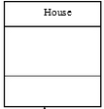
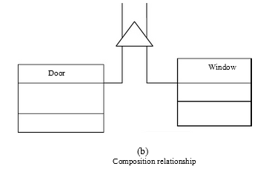
Composition relationship

Slide 45
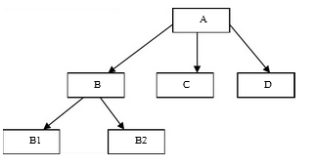
Hierarchical chart

Slide 46
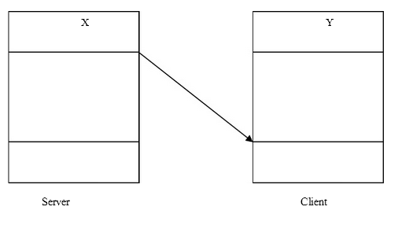
Client-server relationship

Slide 47
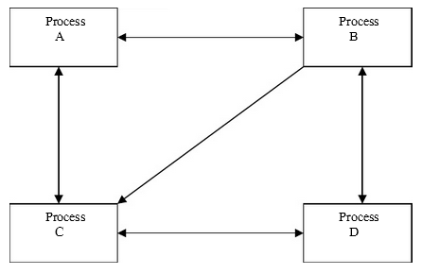
Process layering
Each process is a collection of objects and is assigned a task.
These processes interact and together they bring /achieve a better functionality.

Slide 48
Object–Oriented Analysis
Object-oriented analysis provides us with simple, yet powerful, mechanism for identifying objects, the building block of the software to be developed.
The analysis is basically concerned with the decomposition of a problem into its component parts and establishing a logical model to describe the system functions.

Slide 49
The object-oriented analysis (OOA) approach consists of the following steps:
1. Understanding the problem.
2. Representing the specification of requirement of the user and the software.
3. Identifying the objects and their attributes.
4. Identifying the services that each object is expected to provide (interface).
5. Establishing inter-connections (collaborations) between the objects in terms of services required and services rendered.
Although the above tasks are shown as a series of discrete steps, the last three activities are carried out inter-dependently.

Slide 50
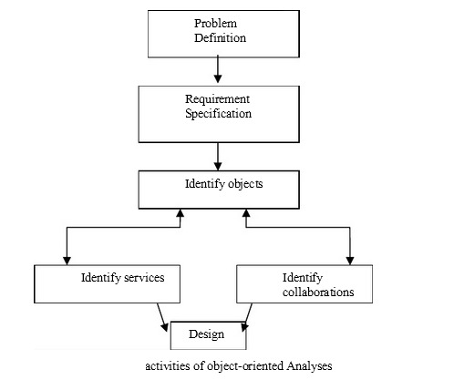
Activities of Object Oriented Analysis

Slide 51
Steps/Activities of Object Oriented Analysis
1. Problem Understanding
The first step in the analysis process is to understand the problem of the user. The problem statement should be refined and redefined in terms of computer system engineering that could suggest a computer-based solution. The problem statement should be stated, as far as possible, in a single, grammatically correct sentence. This will enable the software engineers to have a highly focused attention on the solution of the problem.
The problem statement provides the basis for drawing the requirements specification of both the user and the software.

Slide 52
Requirements Specification
Once the problem is clearly defined, the next step is to understand what the proposed system is required to do. It is important at this stage to generate a list of user requirements. A clear understanding should exist between user and the developer of what is required. Based on the user requirements, the specification for the software should be drawn.
The developer should state clearly:
• What outputs are required?
• What processes are involved to produce these outputs?
• What inputs are necessary?
• What resources are required?
These specifications often serve as a reference to test the final product for its performance of the intended tasks.

Slide 53
Identification of Objects
Objects can often be identified in terms of the real world objects as well as the abstract objects.
Therefore, the best place to look for object is the application itself. The applications may be analyzed by using one of the following two approaches:
Data flow diagrams(DFD)
Textual analysis(TA)

Slide 54
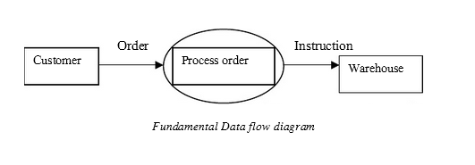
3.1 Data flow diagram
The application can be represented in the form of a data flow diagram indicating how the data moves from one point to another in the system, the boxes and data store in the data flow diagram are good candidate for the objects. The process bubbles correspond to the procedures.
The below figure may be expanded to include more information or condensed to show only one bubble.

Slide 55
DFD for order processing and shipping for a publishing company
Books database
Data store
Bookseller
Process Order
Shipping instructions
Stores
Order
Check credit status
Customer database
Shipping notice
Shipment information
Collect Customer order

Slide 56
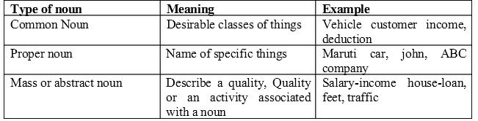
3.2 Textual Analysis
This approach is based on the textual description of the problem or proposed solution. The description may be of one or two sentences or one or two paragraphs depending on the type and complexity of the problem. The nouns are good indicators of the objects. The names can be further classified as proper nouns, common nouns, and mass or abstract nouns.
Table shows the various types of nouns and their meaning.

Slide 57
Textual Analysis
It is important to note that the context and semantics must be used to determine the noun categories.
A particular word may mean a common noun in one context and a mass or abstract noun in another. These approaches are only a guide and note the ultimate tools.
Creative perception and intuition of the experienced developers play an important role in identifying the objects.
Using one of the above approaches, prepare a list of objects for the application problem.
This might include the following task:
1. Prepare an object table.
2. Identify the object that belongs to the solution space and those which belong to the problem space only. The problem space objects are outside the software boundary.
3. Identify the attributes of the solutions space objects.

Slide 58
Identification of services
Once the objects in the solutions space have been identified, the next step is to identify a set of services (functions) that each object should offer.
Services are identified by examining all the verbs and verb phrases in the problem description statement.
Doing verbs and compare verbs usually give rise to services(called as functions in c++).
Being verbs indicate the existence of the classification structure while having verbs give rise to the composition structures

Slide 59
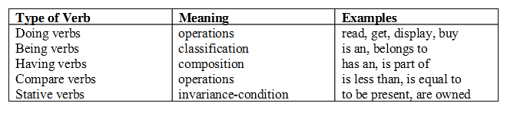
Verbs which can note actions or occurrences may be classified as shown in above table

Slide 60
Establishing interconnections
This step identifies the services that objects provide and receive. We may use an information flow diagram (IFD) or an entity-relationship(ER) diagram to enlist this information.

Slide 61
Object-Oriented Design
Design is concerned with a mapping of objects in the problem space into objects in the solution space, and creating an overall structure and computational models of the system.
This stage normally uses the bottom-up approach to build the structure of the system and the top-down functional decomposition approach to design the class member function that provides services.
Reusability of classes from the previous designs, classification of the objects into subsystems and determination of appropriate protocols are some of the considerations of the design stage. The object oriented design (OOD) approach may involve the following steps:
1. Review of objects created in the analysis phase.
2. Specification of class dependencies.
3. Organization of class hierarchies.
4. Design of classes.
5. Design of member functions.
6. Design of driver program.

Slide 62
1. Review of Problem Space Objects
An exercise to review the objects identified in the problem space is undertaken as a first step in the design stage.
The main objective of this review exercise is to refine the objects in terms of their attributes and operations and to identify other objects that are solution specific.
Some guidelines that might help the review process are:
If only one object is necessary for a service, then it operates only on that object.
If two or more objects are required for an operation to occur, then it is necessary to identify which object’s private part should be known to the operation.
If an operation requires knowledge of more than one type of objects, then the operation is not functionally cohesive and should be rejected.

Slide 63
2. Class Dependencies
Analysis of relationships between the classes is central to the structure of a system.
Therefore, it is important to identify appropriate classes to represent the objects in the solution space and establish their relationships.
The major relationships that are important in the context of design are:
1. Inheritance relationships.
2. Containment relationship.
3. Use relationships.

Slide 64
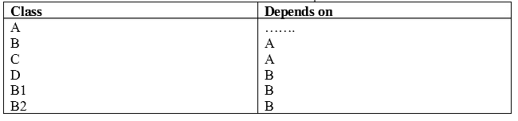
2.1 Inheritance relationship
Inheritance relationship is the highest relationship that can be represented in C++. It is a powerful way of representing a hierarchical relationship directly. The real appeal and power of the inheritance mechanism is that it allows us to reuse a class that is almost, but not exactly, what we want and to tailor the class in a way that is does not introduce any unwanted side effects into the rest of the class.
We must review the attributes and operations of the classes and prepare an
inheritance relationship table as shown in Table

Slide 65
2.2 Containment relationship
It means the use of an object of a class as a member of another class.
This is an alternative and complimentary technique to use the class inheritance.
But, it is often a tricky issue to choose between the two techniques.
Normally, if there is need to override attributes or functions, then the inheritance is the best choice.
On the other hand, if we want to represent a property by a variety of types, then the containment relationship is the right method to follow.
Another place where we need to use an object as a member is when we need to pass an attribute of a class as an argument to the constructor of another class.
The “another” class must have a member object that represents the argument.
The inheritance represents is a relationship and the containment represents has a relationship.

Slide 66
2.3 Use relationship
Use relationship gives information such as the various classes a class uses and the way it uses them.
For example, a class A can use classes B and C in Several ways:
1. A reads member of B
2. A calls a member of C
3. A creates B using new operator

Slide 67
Organization of Class Hierarchies
In the previous step, we examined the inheritance relationships. We must re-examine them and create a class hierarchy so that we can reuse as much data and/or functions that have been designed already.
Organization of the class hierarchies involves identification of common attributes and functions among a group of related classes and then combining them to form a new class.
The new class will serve as the super class and the others as subordinate classes. The new class may or may not have the meaning of an object by itself. If the object is created purely to combine the common attributes, it is called an
abstract class.
This process may be repeated at different level of abstraction with the sole objective of extending the classes. As hierarchy structure becomes progressively higher, the amount of specification and implementation inherited by the lower level classes increase.
We way repeat the process until we are sure that no new class can be formed

Slide 68
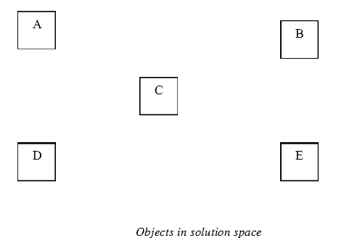
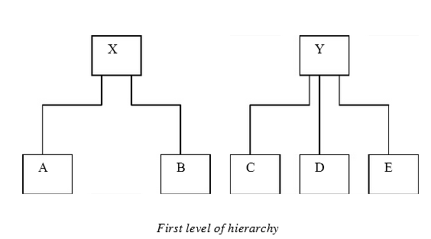

Slide 69
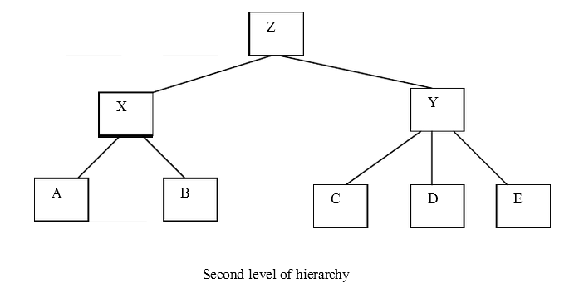

Slide 70
Design of Classes
We have identified classes, their attributes, and minimal set of operations required by the concept a class is representing. Now we must look at the complete details that each class represents. The important issues is to decide what function are to be provided. For a class to be useful, it must contain the following functions, in addition to service functions:
1. Class management functions.
How an object is created?
How an object is destroyed?
2. Class implementation functions.
What operations are performed on the data type of a class?
3. Classes access functions.
How do we get information about the internal variables of the class?
4. Class utility functions.
How do we handle errors?

Slide 71
Class design.. Contd
Other issues that are to be considered are:
What kinds of access controls are required for the base classes?
• Which function can be made virtual?
• What library classes are expected to be used in a class?
The design of the individual classes has a major impact on the overall quality of the software
Given below are some guidelines which should be considered while designing a class:
• The public interface of a class should have only functions of the class.
• An object of one class should not send a message directly to a member of another class.
• A function should be declared public only when it is required to be used by the objects of the class.
• A class should be dependent on as few classes as possible.
• Interaction between two classes must be explicit.
• The top class of a structure should represent the abstract model of the target .

Slide 72
Design of Member Functions
We have so far identified Classes and objects, Data members, Interfaces, Dependencies, and Class hierarchy (structure) .
It is time now to consider the design of the member functions.
The member functions define the operations that are performed on the object’s data.
These functions behave like any other C function and therefore we can use the top-down functional decomposition technique to design them as shown in fig.

Slide 73
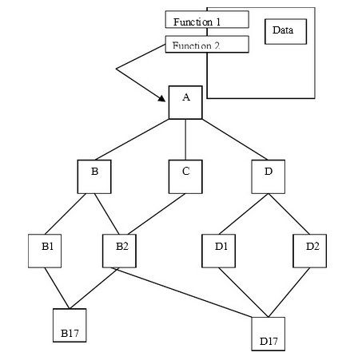
Top down design of functions
Modules of function 2

Slide 74
Design of the Driver Program
Every C++ program must contain a main () function code known as the driver program. The executions of the program begin and end here.
The driver program is mainly responsible for:
• Receiving data values from the user,
• Creating objects from the class definitions,
• Arranging communication between the objects as a sequence of message for invoking the member functions, and
• Displaying output results in the form required by the user.
All activities, including processing during the execution of the program, result from the mutual interactions of the objects. One major design decision made is the logical order of the messaging passing.

Slide 75
Department of CSE
S4 CS- Object Oriented Programming ( CS010402)
Questions for Assignment II
1. Describe the various approaches by which we can detect end-of-file condition. Provide sample programs for illustrating the same.
2. Write a program
That creates a data file that stores the list of names and telephone numbers. Names and telephone numbers are to be separated by white space. Use a class object to store each set of data.
Write a program to read data from the above file and output the list in two columns. The names must be left justified and numbers must be right justified.
Write an interactive , menu driven program that will access the above file. Implement the above tasks.
Determine the phone number of specified person
Determine name if phone number is given
Update phone number , if there is a change

